Slide 1
CSE 471: MACHINE LEARNING
Learning Probabilistic Models

Slide 2
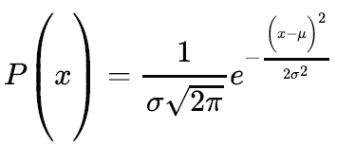
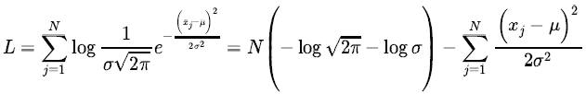
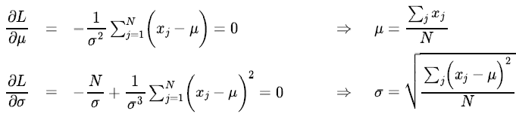
ML parameter learning (Continuous model)

Slide 3
The EM Algorithm

Slide 4
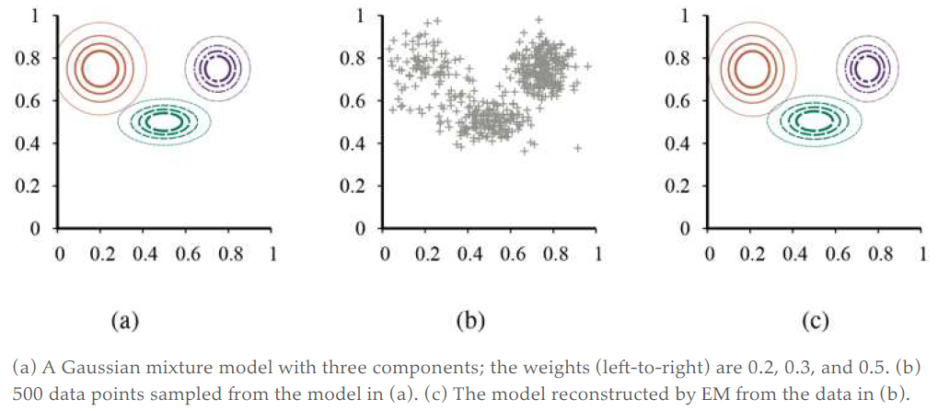
Gaussian mixture model

Slide 5

Mixture distribution
k components
Each component is a distribution itself
C is the random variable denoting the component

Slide 6
Mixture of Gaussians
Each component is a multivariate Gaussian
Parameters
  The weight of each component, w_{i} = P(C = i)
  The mean of each component, (mu)
  The covariance of each component ∑_{i}

Slide 7
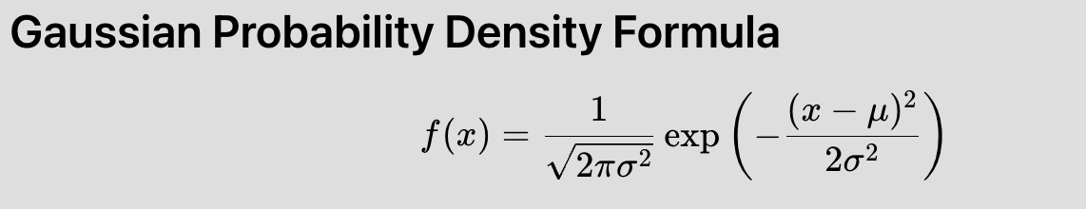
Mixture of Gaussians
﻿If we knew the parameters of each component -> ﻿ ﻿we could ﻿assign each data point to a component.

Slide 8
Mixture of Gaussians
﻿If we knew which component generated each data point -> ﻿ It would be easy to recover the component Gaussians

Slide 9
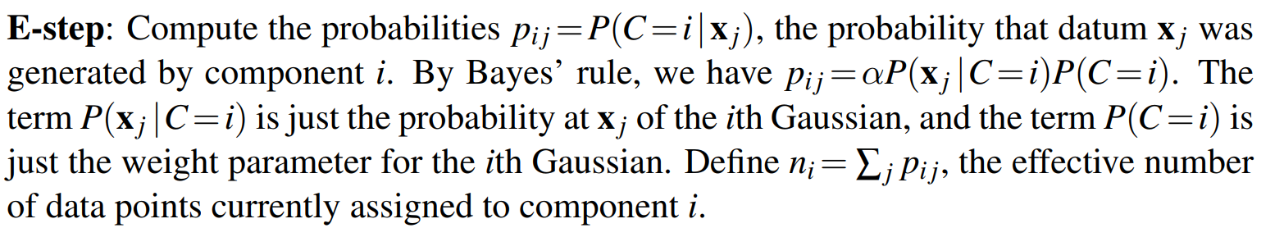
Solving by EM Algorithm
Initialize the parameters arbitrarily
E-Step
Notes:
The E-step, or expectation step, can be viewed as computing the expected values p_{ij} of the hidden indicator variables Z_{ij} , where Z_{ij} is 1 if datum was generated by the i^{th} component and 0 otherwise.
The M-step, or maximization step, finds the new values of the parameters that maximize the log likelihood of the data, given the expected values of the hidden indicator variables.

Slide 10
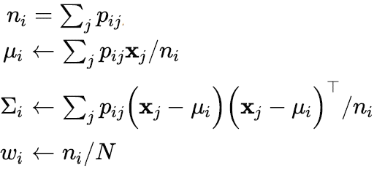
Solving by EM Algorithm
Initialize the parameters arbitrarily
M-Step
Notes:
The E-step, or expectation step, can be viewed as computing the expected values p_{ij} of the hidden indicator variables Z_{ij} , where Z_{ij} is 1 if datum was generated by the i^{th} component and 0 otherwise.
The M-step, or maximization step, finds the new values of the parameters that maximize the log likelihood of the data, given the expected values of the hidden indicator variables.

Slide 11
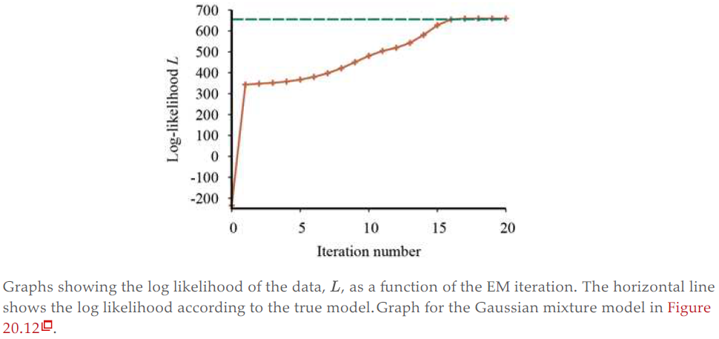
Log likelihood increasing
Notes:
EM increases the log likelihood of the data at every iteration. This fact can be proved in general.

Slide 12
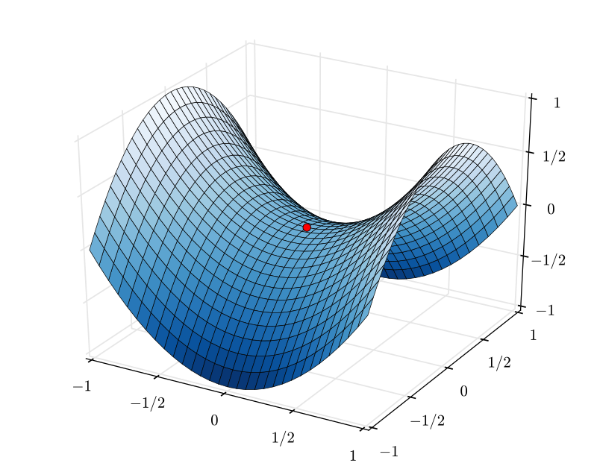
Saddle Point
Notes:
Under certain conditions (that hold in most cases), EM can be proven to reach a local maximum in likelihood.
In rare cases, it could reach a saddle point or even a local minimum.

